Slide 1
Dr. Cory Bart
Visiting Assistant Professor
Here through the Spring
Introductory computing courses
Computational Thinking
Intro to Python
Independent Study/Paid Projects
acbart.com
acbart@vt.edu

Slide 2

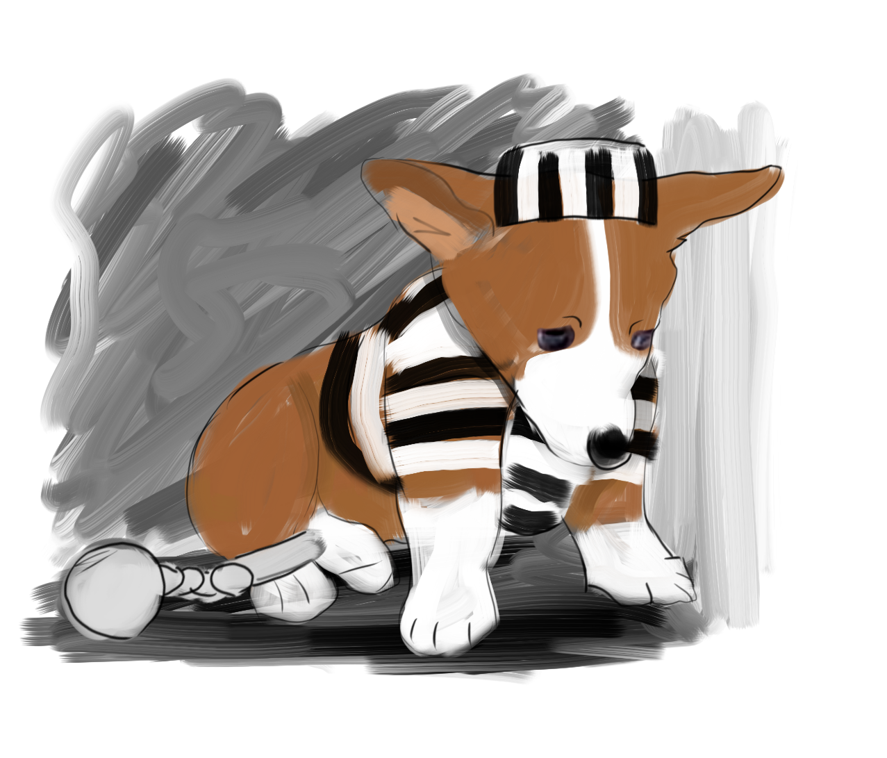

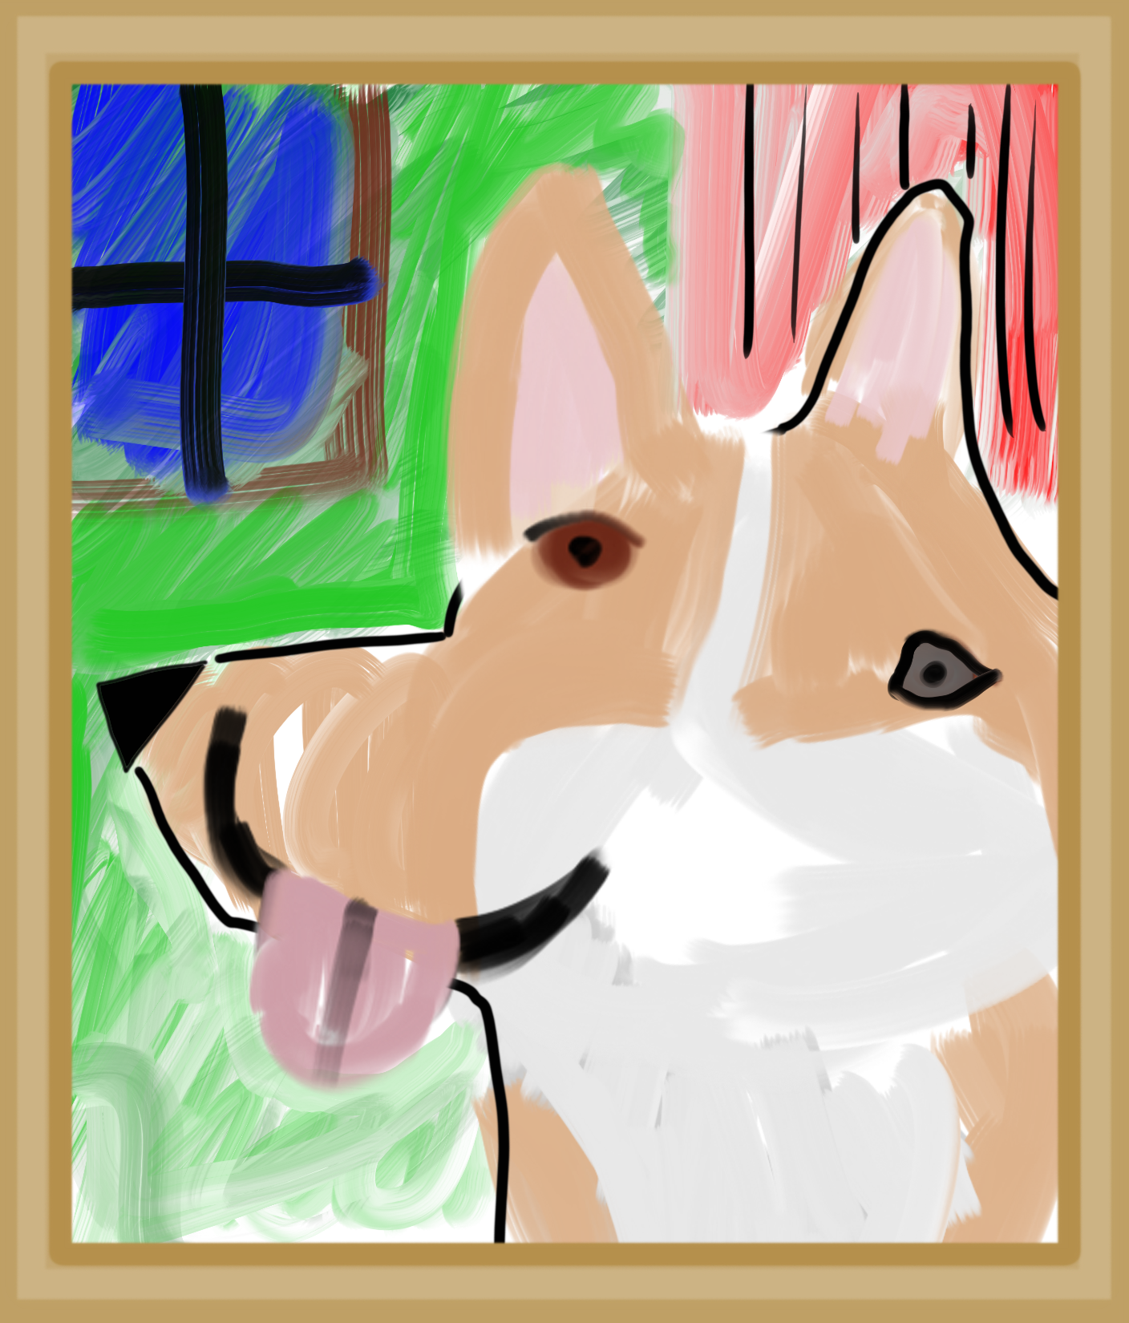
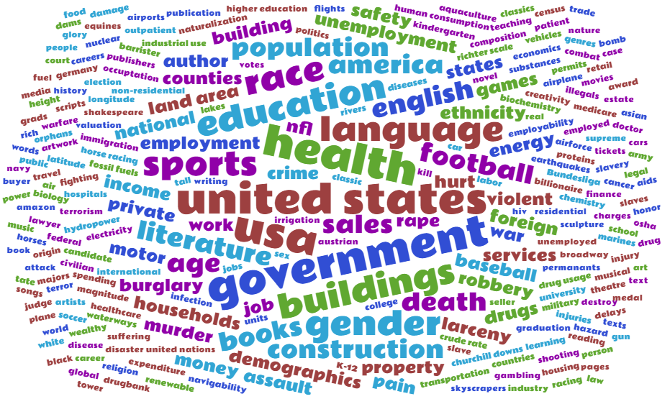
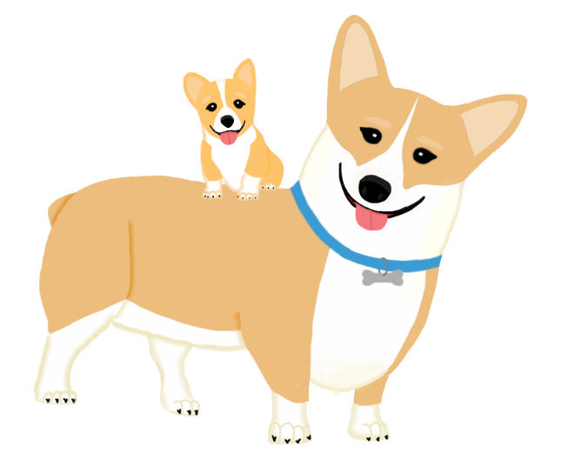
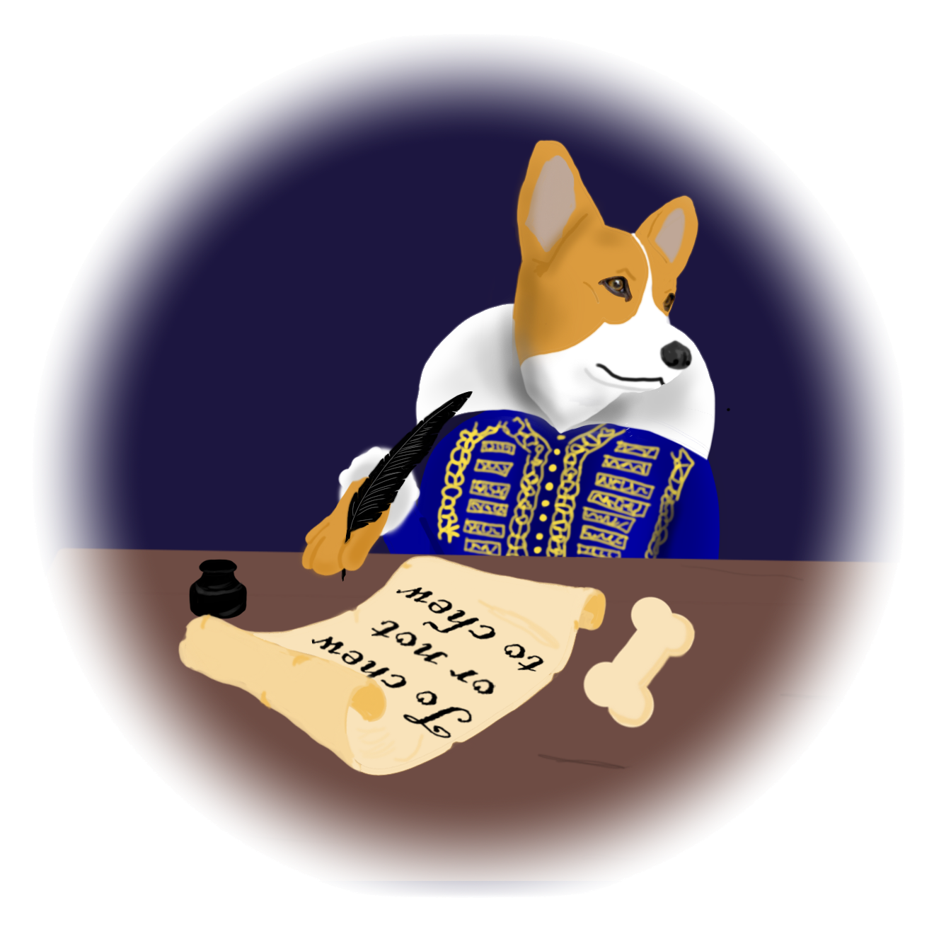


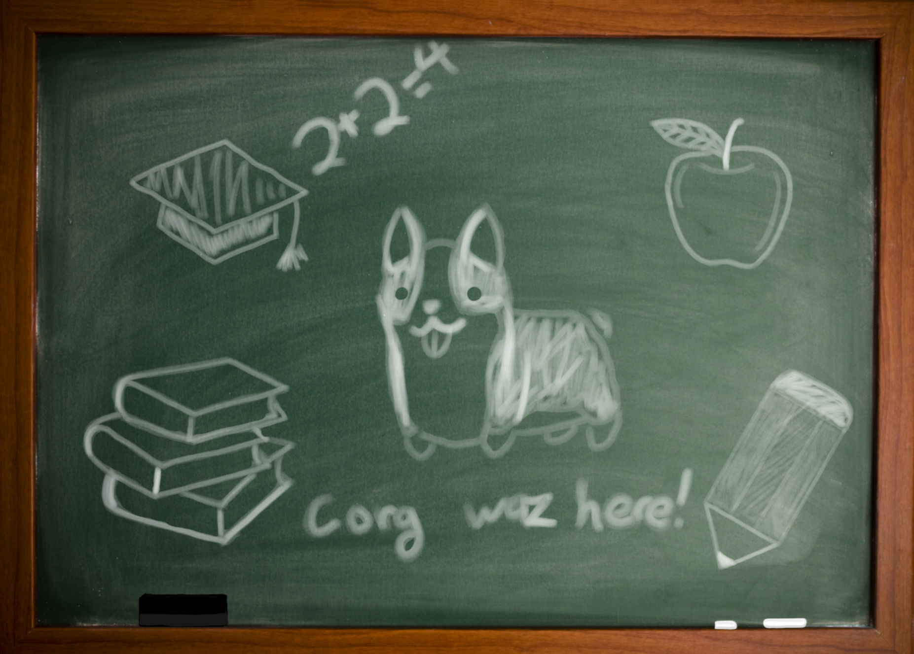
40+ Datasets in History, Medicine, Geology, Education, Finance, Construction, Literature, Politics, and more
CORGIS
(Collection Of Really Great and Interesting dataSets)
think.cs.vt.edu/corgis
Open-source, open-access project for contextualizing introductory computing experiences with real-world data
Data Science Learning Opportunity
Making new Datasets
Cleaning up old Datasets
Building Learning Experiences

Slide 3
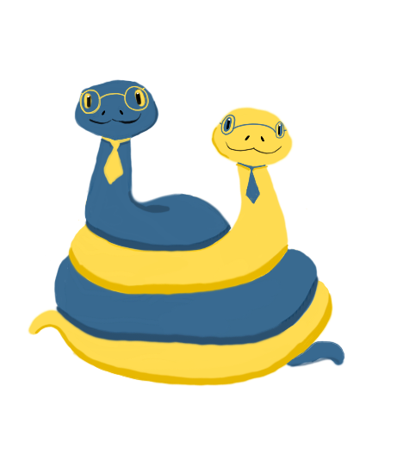
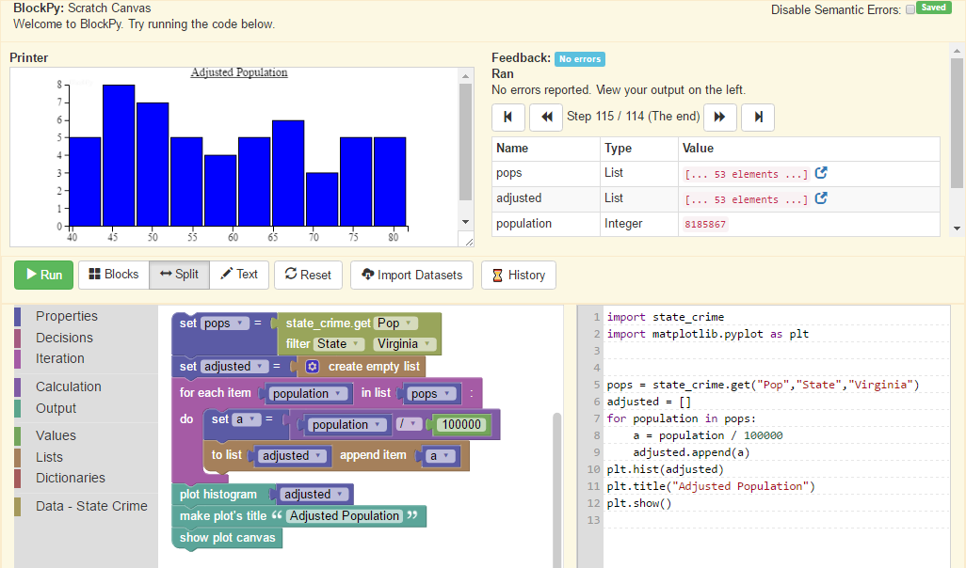
BlockPy
www.blockpy.com
Features
Dual Block/Text
Immediate Feedback
Client-side Python Execution
Program Analysis
Canvas Integration
Research Projects
Integrated Worked Examples
Python Type Inferencing
Server-side Execution in NodeJS

